Slide 1

Gen-AI Remote Sensing
Milestone 2
Lingampelli Srinivas
Team: G247

Slide 2
Introduction:
Enhancing SAR Image Analysis with Gen-AI
Synthetic Aperture Radar (SAR) images are crucial for remote sensing applications, offering robust imaging capabilities under all weather conditions and interpreting these images is challenging due to their speckle noise and grayscale format.
Solution:
Leverage Generative AI (Gen-AI) techniques to enhance SAR image interpretation by:
Colorizing SAR images for improved readability and insights.
Detecting and mapping flood-affected areas.
Bridging SAR crop images with their corresponding ground crop images.

Slide 3
Main Components of the solution:
1. Flutter App (Frontend)
- User Interface
- Send SAR images to backend flask API
- Display the Gen AI images generated by
Gen-AI models
2. Flask Backend (Server)
- API endpoints to handle requests from the Flutter app
- Contains three Gen AI models for
Three primary tasks: Crop
Classification, SAR Image Colorization
& Flood Detection
- Communicates with Firebase for data storage and
retrieval
3. AI Models:
- VGG-16 for Crop Classification
- Pix2Pix for SAR Image Colorization
- UNETR for Flood Affected Area Detection
via Image Segmentation
4. Firebase (Storage)
- Stores user data and SAR images
- Manages authentication and user profiles
5. Deployment:
- Docker and AWS for containerized Backend
Deployment

Slide 4
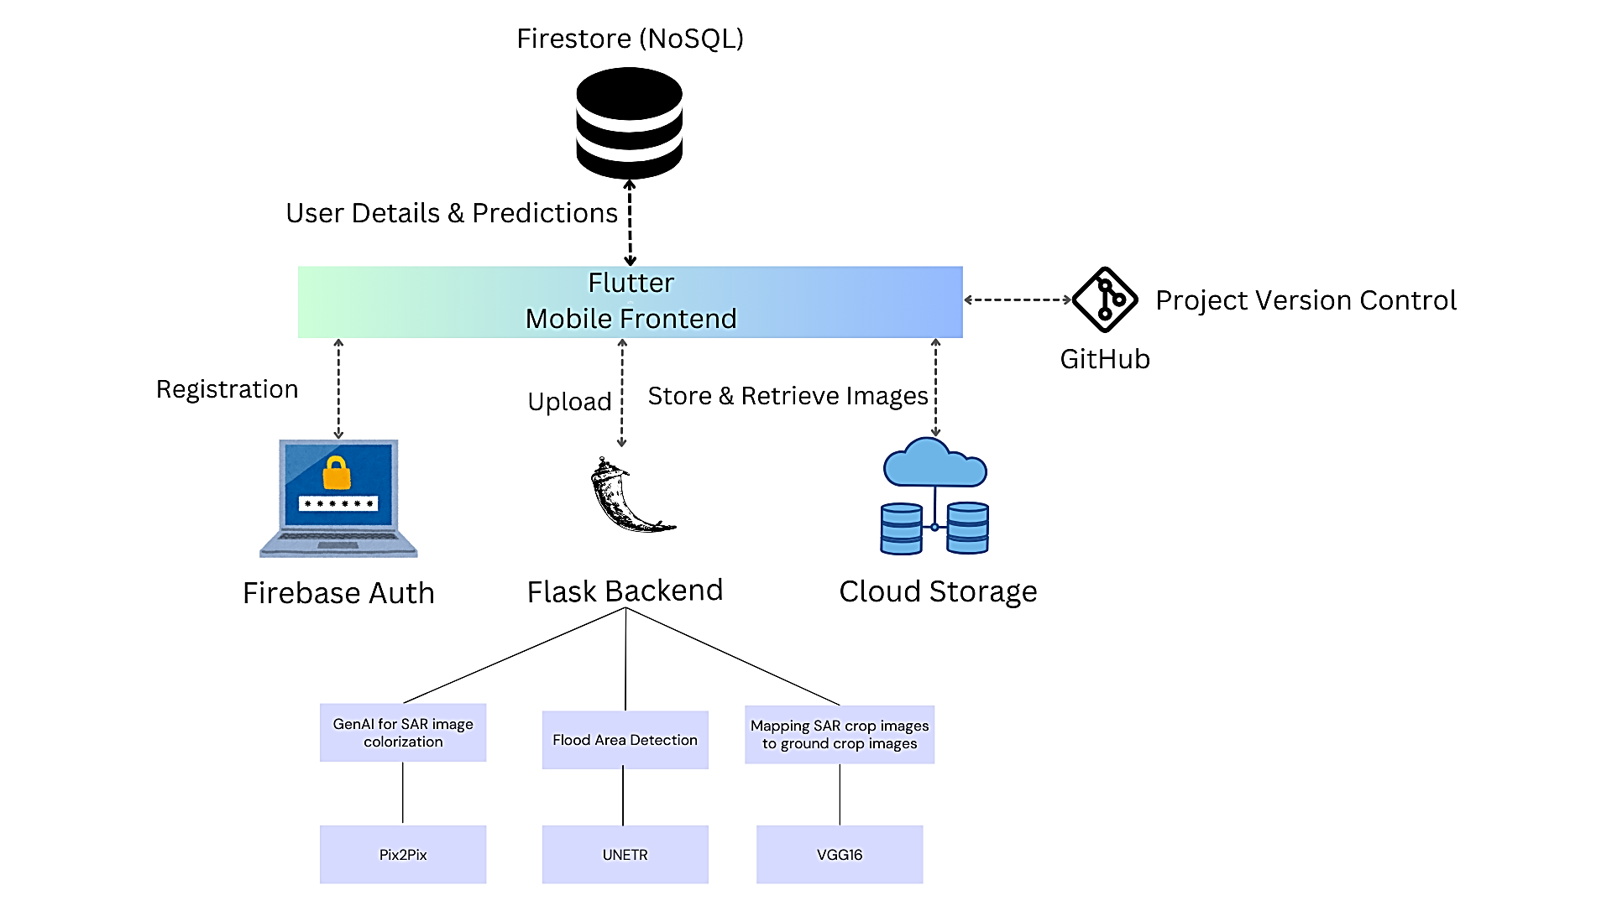
Project Architecture

Slide 5
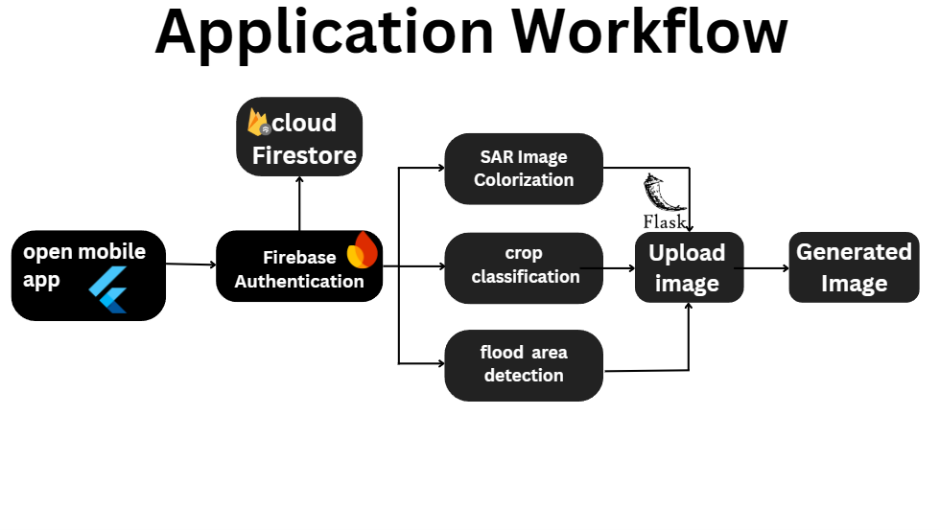
Workflow

Slide 6



Communication Between Components
Image data sent to Flask API
Flask server analyzes the images and generates an output
Results are sent back to flutter!
- Flutter App ↔️ Firebase: Firebase SDK/REST
- User data, including image data are stored and retrieved using Firebase API

Slide 7
Tech Stack
Interfaces to be Developed
- Frontend: Flutter
- Backend: Flask
- Machine Learning: TensorFlow/PyTorch
- Storage: Firebase (Firestore for database, Firebase Storage for images)
- Development Tools: Android Studio (for Flutter), Jupyter Notebooks (for Gen AI model development & Training)
1. User Interfaces
- Login/Signup screen
- Dashboard Screen
- Crop Classification Screen
- SAR Image Colorization
- Flood Area Detection
2. API Endpoints (Flask)
- `POST /predict`: Accept Crop Image and
return the Mapped Image
- `POST /sar`: Accepts SAR images and
returns Colorized Images
- `POST /fad`: Accepts SAR Images and
display Flood affected areas

Slide 8
Business Logic
2. User Management Logic:
Authentication and Authorization:
Secure user registration and login using Firebase Authentication.
Ensure users have role-based access for uploading SAR images and viewing results.
1. Image Processing Logic:
Colorization:
Use the Pix2Pix model to convert grayscale SAR images into colorized images.
Flood Detection:
Leverage the UNETR model to analyze SAR images and detect flood-affected areas.
Crop Mapping:
Use VGG16 for feature extraction and mapping SAR crop images to corresponding ground crop images.
3. Data Storage and Retrieval Logic:
Image Storage:
Save raw SAR images and processed outputs (colorized images, flood maps, crop mapping results) in Firebase Storage.
Results Retrieval:
Store metadata (e.g., image ID,results) in Firebase Firestore.

Slide 9
Datasets and Data Structures
1. Crop Classification Dataset
Classes: 5 crop categories (e.g., wheat, rice, etc.)
Training: 40 images per class (200 total)
Validation: 10 images per class (50 total)
2. Sentinel-1 & 2 Dataset for Colorization
Total Image Pairs: 16,000 SAR (Sentinel-1) & optical (Sentinel-2) image pairs
Geographic Areas: Agricultural, grasslands, urban, barren
Split: 80% train (12,800), 20% validation (3,200)
Data Structures used:
User Data for storing in Firestore: Key-Value pairs of Strings
Images: Bit Arrays During API requests, 2D Arrays during processing

Slide 10
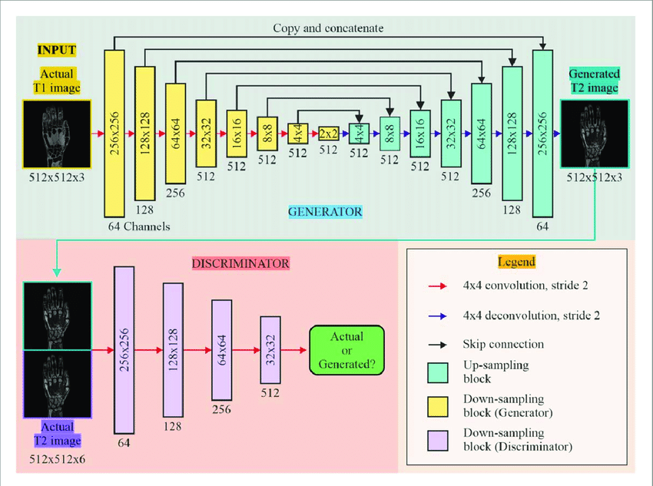
Pix2Pix Architecture (GAN)

Slide 11
Generator and Discriminator in Pix2Pix
Generator (U-NETR)
The main aim of the generator is to transform a SAR image into an RGB or colorized version of the image.
It tries to generate RGB images that closely resemble the real RGB images
It works on the principle of encouraging the discriminator classify the generated image as real image
Discriminator (PatchGAN)
It evaluates the pixel level differences between the generated RGB images and the real RGB images.
As the name suggests, It divides the images into small patches using the PatchGAN and classifies each one
It provides feedback to the generator, helping it reduce the loss value over time.

Slide 12
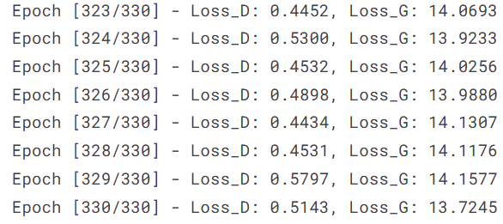
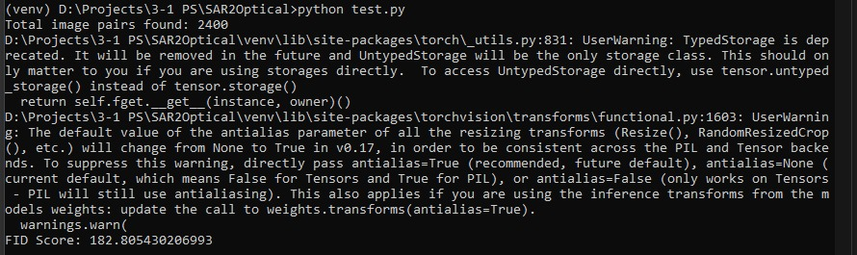
Fréchet Inception Distance(FID)
FID evaluates the quality of images generated by models like Pix2Pix.
How it works: Compares the Pixel wise feature distribution between the generated and real images using a pretrained Inception Model
Metric: Calculates the Frechet distance between the means and covariances of these feature distributions.
Interpretation: Lower FID scores indicate better quality (more realistic) generated images.
After training our Pix2Pix model for 330 epochs with a batch size of 64 the model achieved a FID of 182.805 on the validation set.

Slide 13
Flood Detection of SAR Images Using UNETR

Slide 14
WHAT IS UNETR?
UNETR (U-Net with Transformer Encoder) is an advanced neural network architecture for semantic segmentation tasks.
Combines transformer encoders with U-Net for semantic segmentation. Captures global and local features simultaneously.
WHY USE UNETR FOR FLOOD DETECTION?
Accurate segmentation: Identifies flooded vs. non-flooded areas pixel by pixel. Global understanding: Handles irregular flood patterns using transformers.
SAR compatibility: Works we l with noisy VV-polarized SAR images. Scalable: Ideal for high-resolution sate lite imagery.

Slide 15
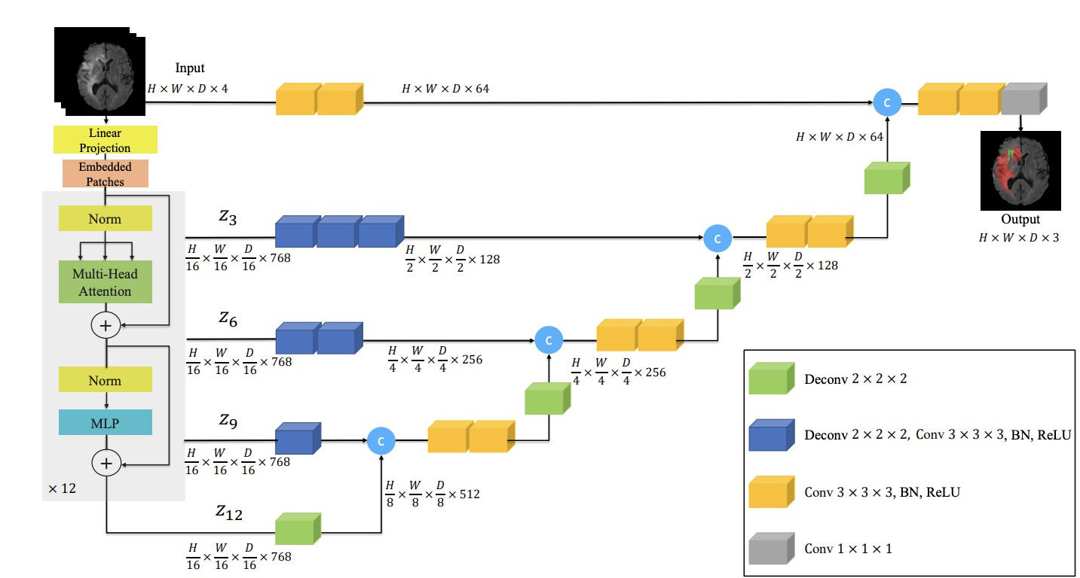
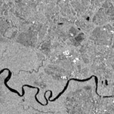
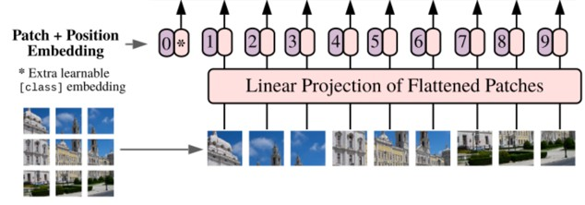
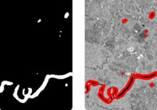
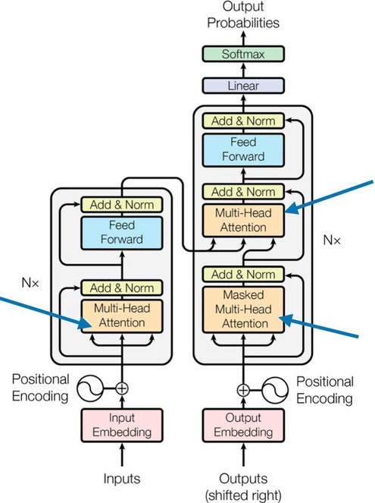
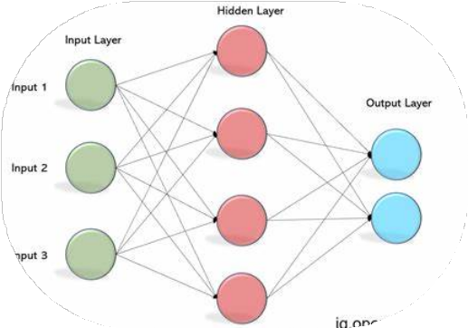
UNETR ARCHITECTURE

Slide 16
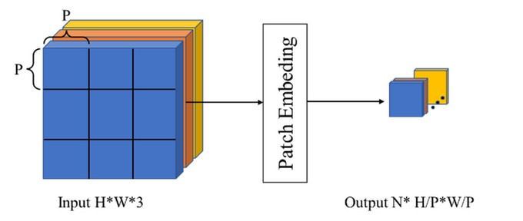


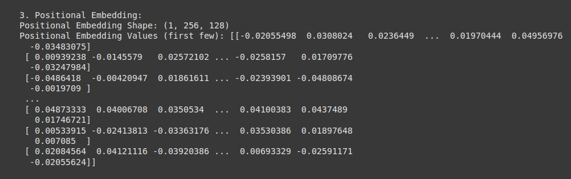
EMBEDDING PATCHES
3D PATCH EMBEDDING (STEP 3)
PATCH EMBEDDING (STEP 1)
POSITIONAL EMBEDDING (STEP 2)

Slide 17
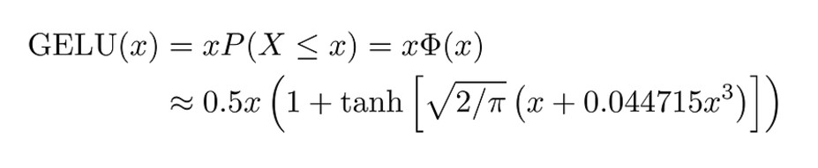
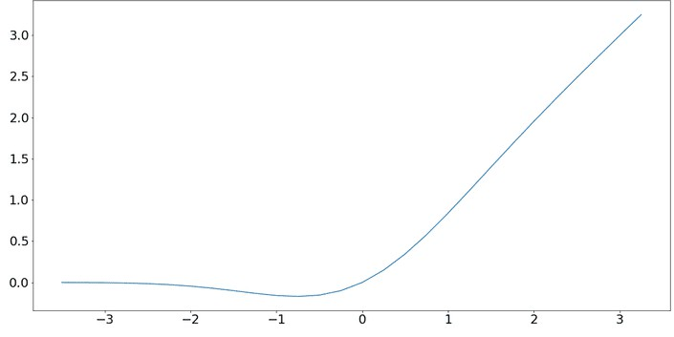
GELU Activation function
Gaussian Error Linear Unit is an activation function used in neural networks.
It applies a smooth, continuous transformation to inputs, unlike ReLU which has a sharp cutoff.
Why GELU?
Smooth Activation: No abrupt cutoffs like ReLU.
Better Gradient Flow: Helps avoid "dead neurons" and allows stable training.
Probabilistic: Activates based on a smooth probability, especially for negative values. Use Cases:
Common in Transformers, like BERT and UNETR for tasks like image segmentation or text processing.

Slide 18
